Slide 1
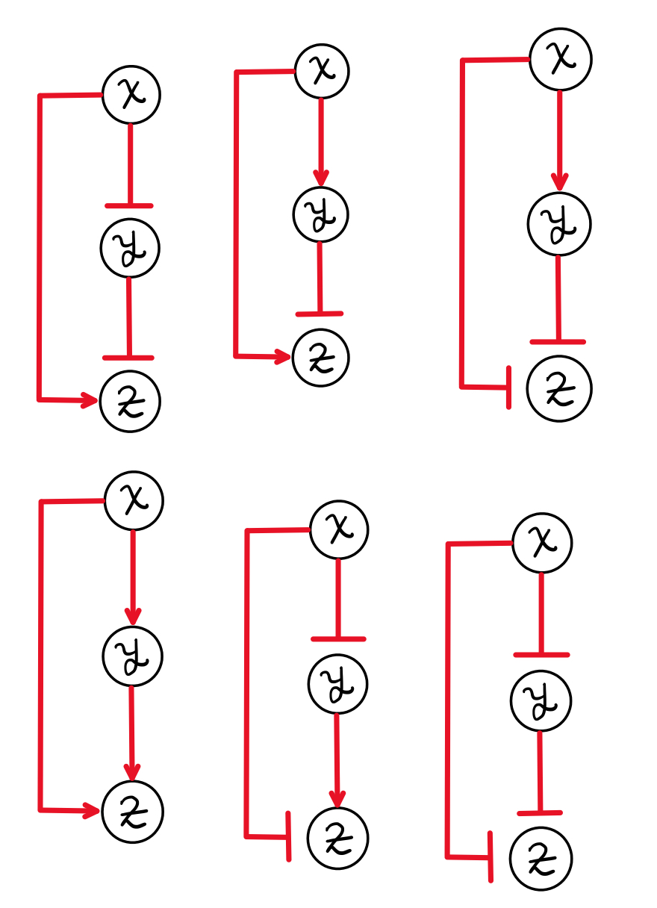
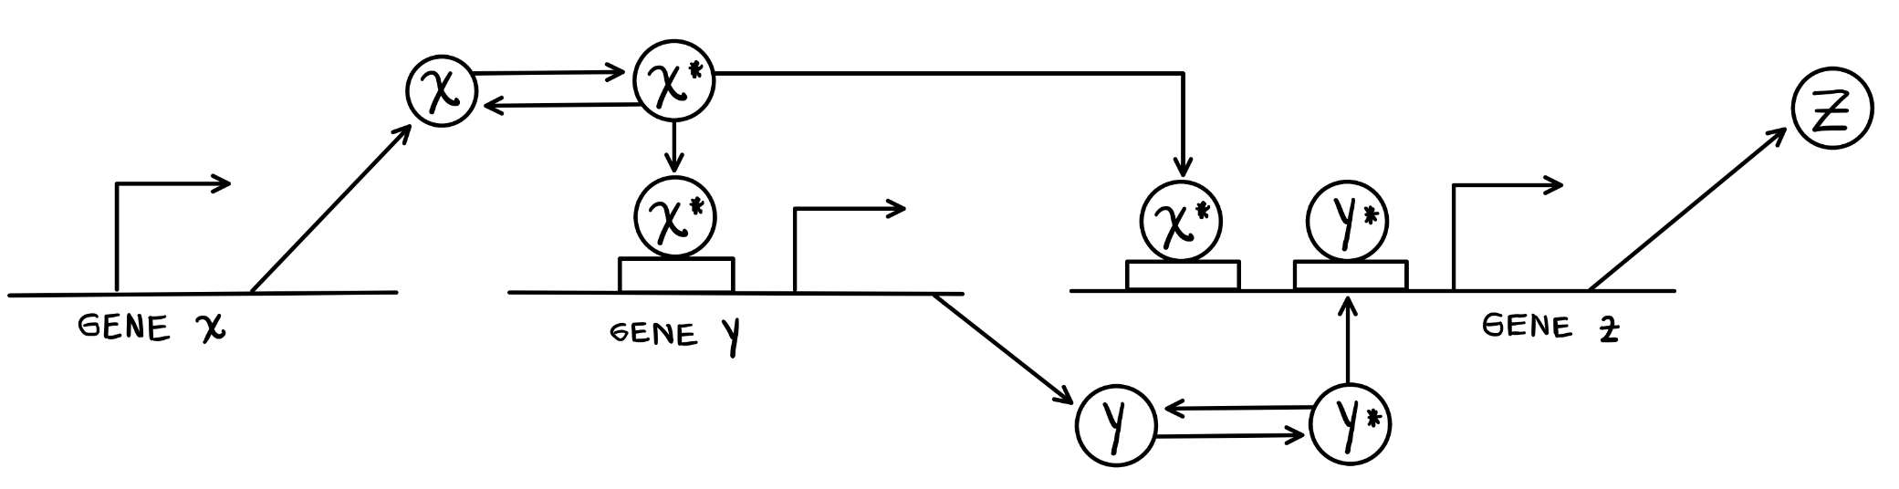

Health, mortality and Human Aging
Rafael Enrique Velásquez Rojas

Slide 2
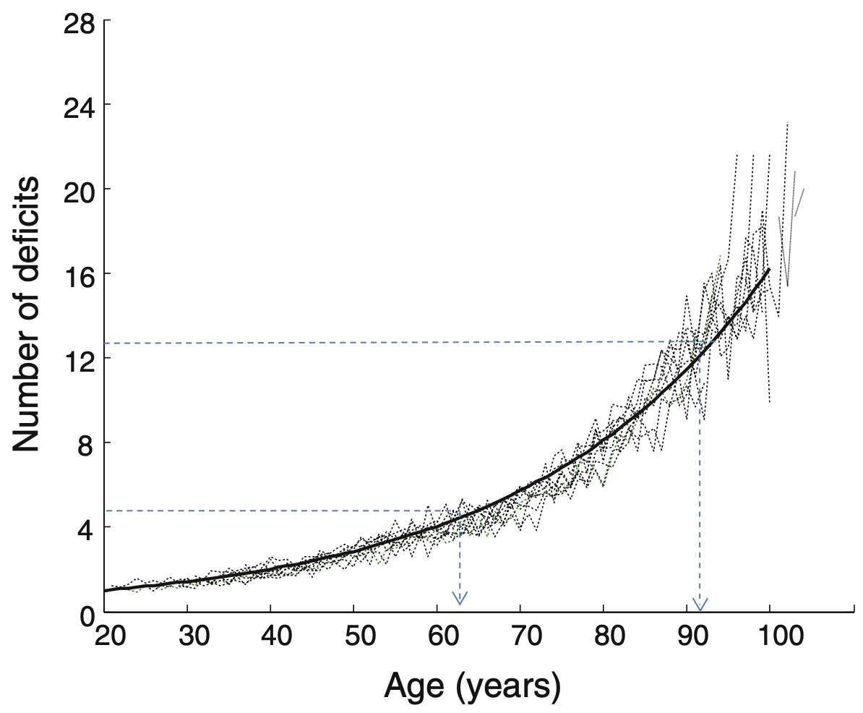
Health worsens with age
Highly heterogeneous
Image from: Mitnitski, A., Song, X., & Rockwood, K. (2013). Assessing biological aging: the origin of deficit accumulation. Biogerontology, 14, 709-717.
Slide 1

Slide 3
Health worsens with age
Highly heterogeneous
Accumulation of deficits with the age
Image from: Mitnitski, A., Song, X., & Rockwood, K. (2013). Assessing biological aging: the origin of deficit accumulation. Biogerontology, 14, 709-717.
Slide 1

Slide 4
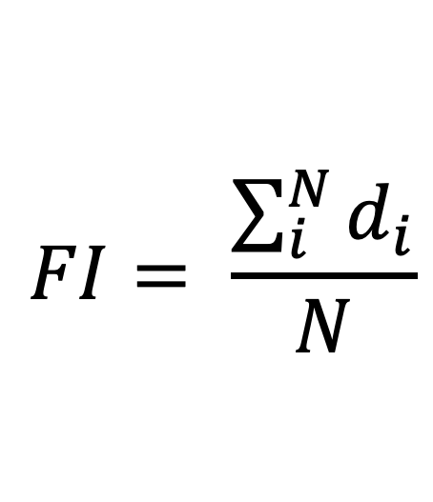
Health worsens with age
Highly heterogeneous
Accumulation of deficits with the age
$$FI= \frac{\sum_{i}^{N}{d_{i}}}{N}$$
Frailty Index as a measure of deficit accumulation
Image from: Mitnitski, A., Song, X., & Rockwood, K. (2013). Assessing biological aging: the origin of deficit accumulation. Biogerontology, 14, 709-717.
Slide 1

Slide 5
Mortality Increase with the Age
Phenomenological behaviour of mortality
Slide 2

Slide 6
Mortality Increase with the Age
Phenomenological behaviour of mortality
Atypical behaviour in the 20s
Slide 2

Slide 7
Mortality Increase with the Age
Phenomenological behaviour of mortality
Atypical behaviour in the 20s
After 40 age = Exponential increment
Slide 2

Slide 8
Gompertz Law to model the exponential increment
Gompertz, B. (1833, December). On the nature of the function expressive of the law of human mortality, and on a new mode of determining the value of life contingencies. In a letter to Francis Baily, Esq. FRS &c. By Benjamin Gompertz, Esq. FR S. In Abstracts of the Papers Printed in the Philosophical Transactions of the Royal Society of London (No. 2, pp. 252-253). London: The Royal Society.
Slide 3
Notes:
Some population there are described by high age independent death rates

Slide 9
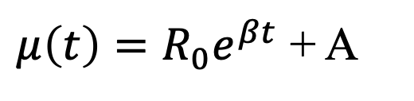
Gompertz Law to model the exponential increment
$μ\left(t\right)=R_{0}e^{βt}$ + A
Exponential model to explain the exponential increment of mortality with age
Sum of age dependent term and age independent term
Slide 3
Notes:
Some population there are described by high age independent death rates

Slide 10
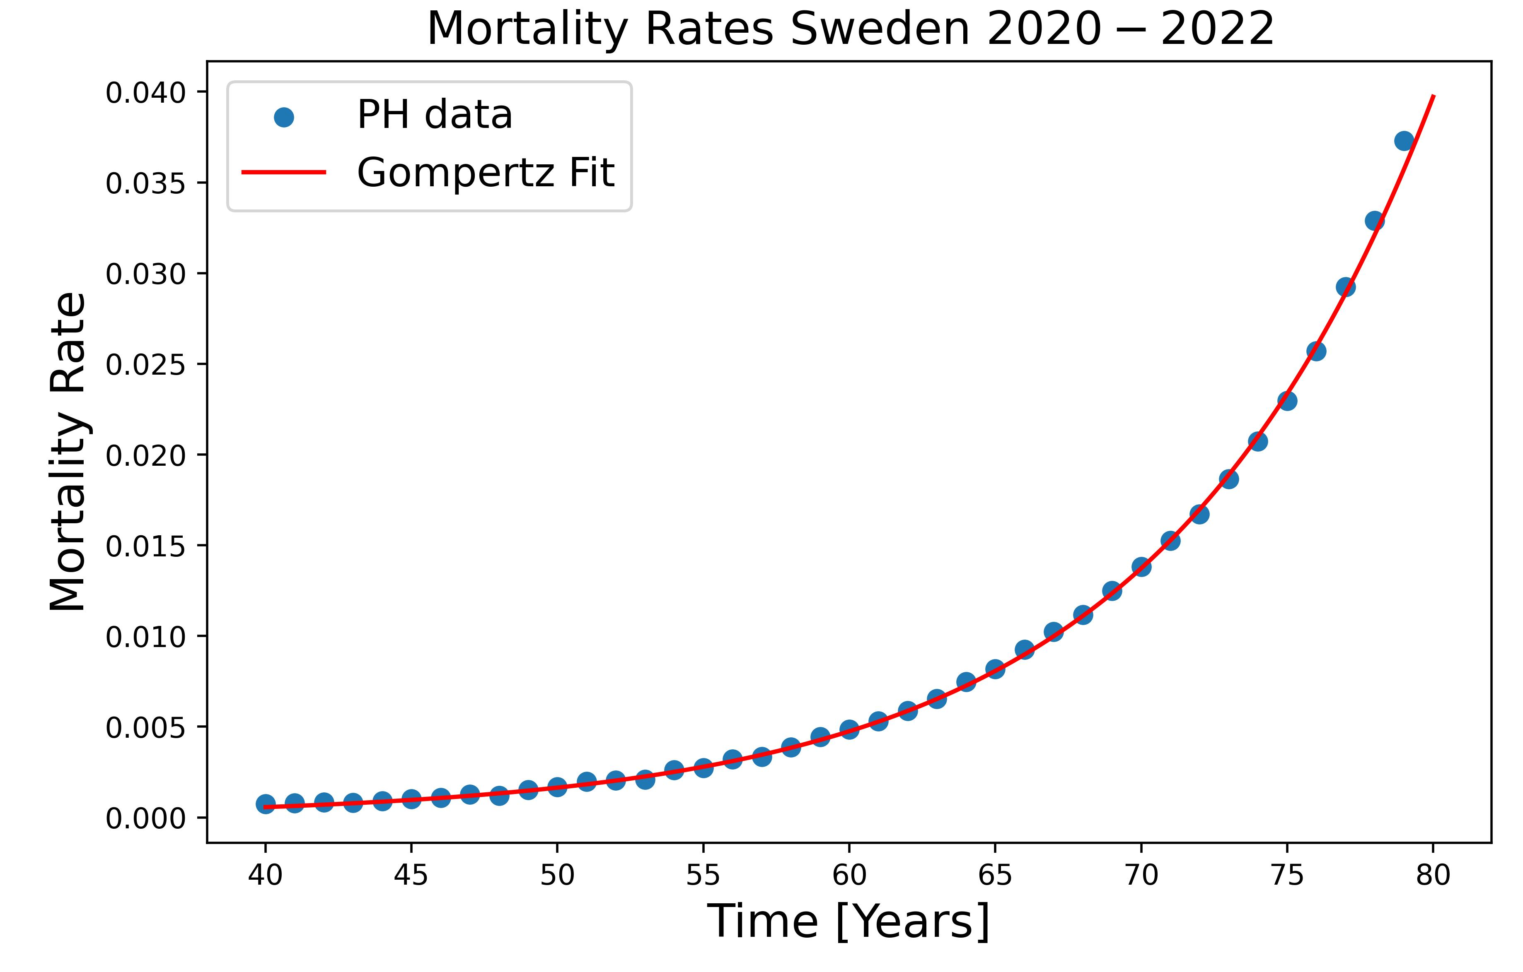
Gompertz Law to model the exponential increment
$μ\left(t\right)=R_{0}e^{βt}$ + A
Exponential model to explain the exponential increment of mortality with age
Sum of age dependent term and age independent term
Slide 3
Notes:
Some population there are described by high age independent death rates

Slide 11
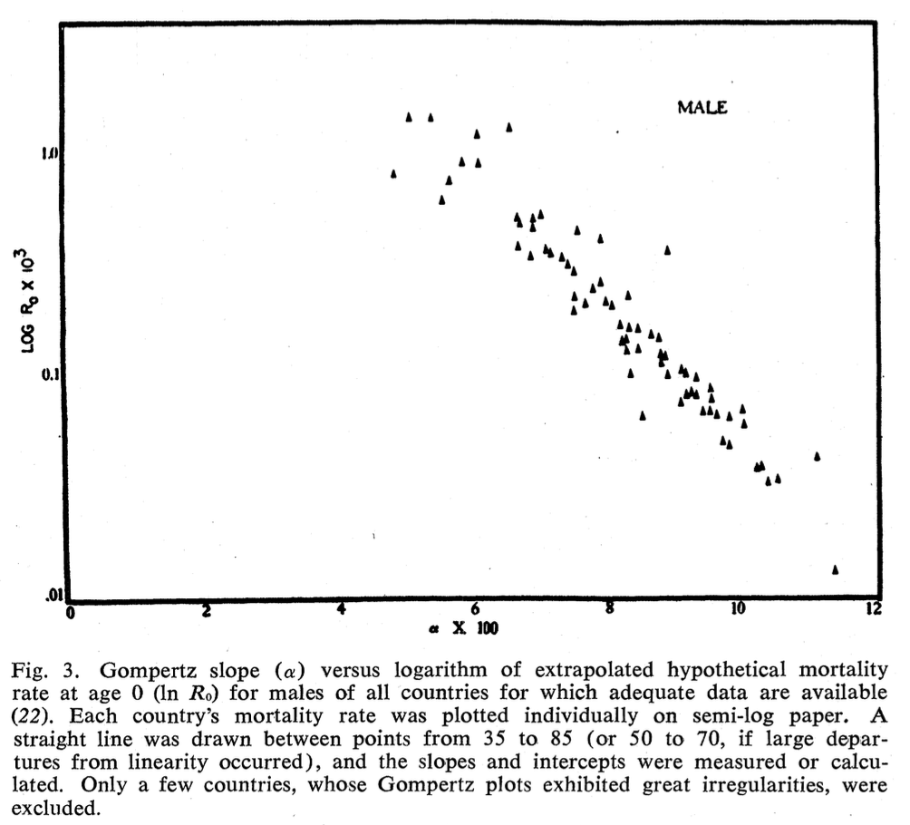
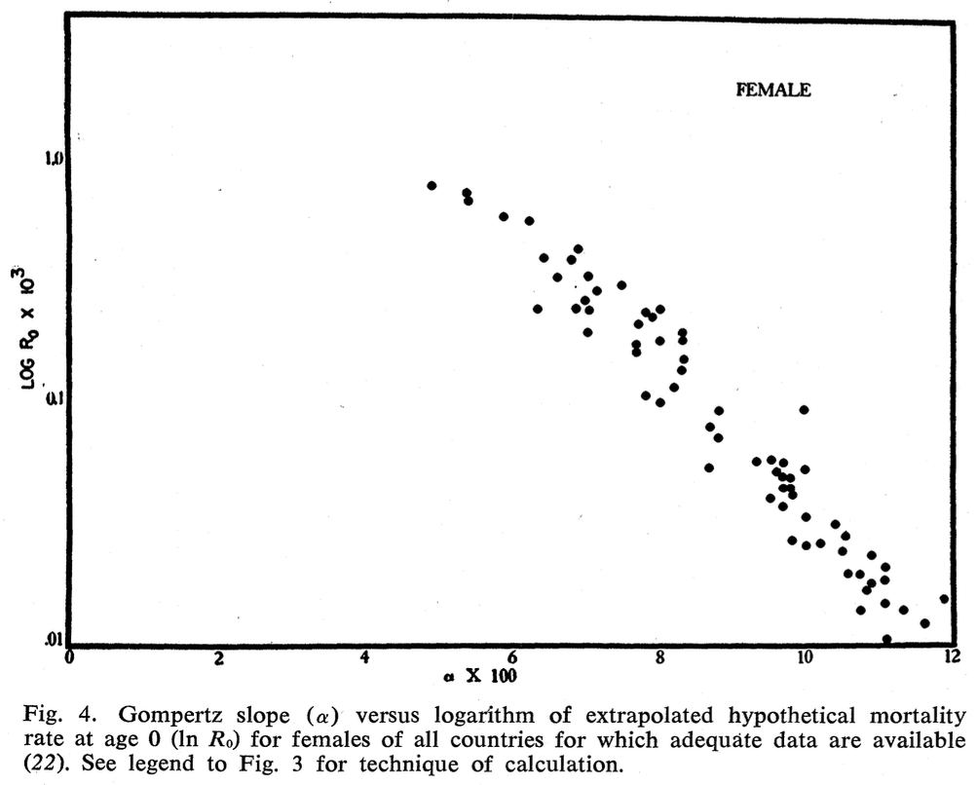
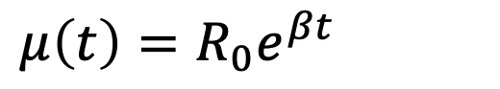
Strehler-Mildvan Correlation
$μ\left(t\right)=R_{0}e^{βt}$
Gompertz Law exponential mortality
Slide 4
Notes:
Some population there are described by high age independent death rates

Slide 12
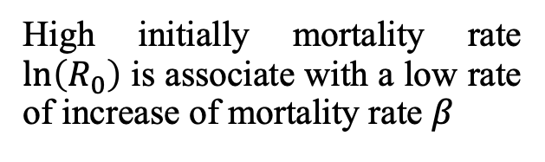
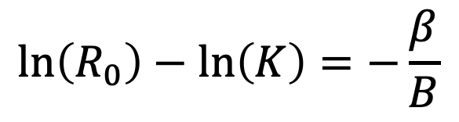
Strehler-Mildvan Correlation
$μ\left(t\right)=R_{0}e^{βt}$
Gompertz Law exponential mortality
$$\ln\left(R_{0}\right)−\ln\left(K\right)=−\frac{β}{B}$$
Correlation between two parameters of Gompertz Law
High initially mortality rate $\ln\left(R_{0}\right)$ is associate with a low rate of increase of mortality rate $β$
Slide 4
Notes:
Some population there are described by high age independent death rates

Slide 13
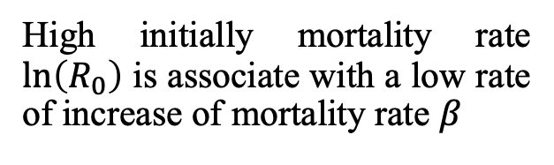
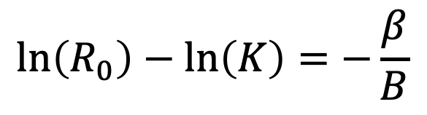
Strehler-Mildvan Correlation
$$\ln\left(R_{0}\right)−\ln\left(K\right)=−\frac{β}{B}$$
High initially mortality rate $\ln\left(R_{0}\right)$ is associate with a low rate of increase of mortality rate $β$
Slide 4
Notes:
Some population there are described by high age independent death rates

Slide 14
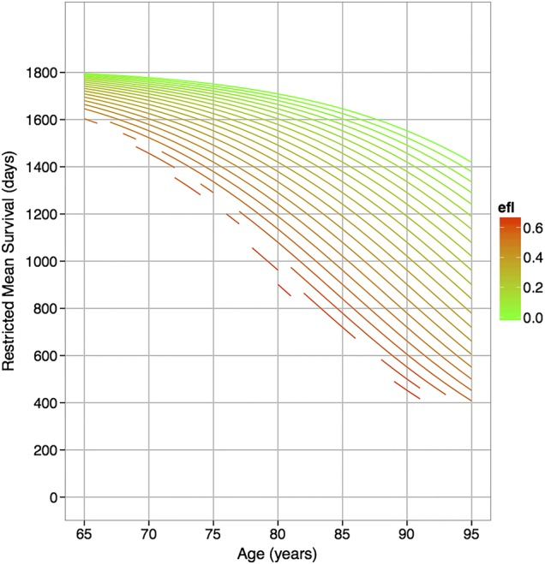
There are a connection between health and death
Worse health measurement leads to a decrease in a restricted mean survival.
Image from: Clegg, A., Bates, C., Young, J., Ryan, R., Nichols, L., Ann Teale, E., ... & Marshall, T. (2016). Development and validation of an electronic frailty index using routine primary care electronic health record data. Age and ageing, 45(3), 353-360.
Slide 6
Notes:
Some population there are described by high age independent death rates

Slide 15

Human Mortality Database
Data resource on mortality in +40 developed countries
Data of:
Deaths
Population Size
Death Rates
Exposure to risk
Slide 7
Notes:
Some population there are described by high age independent death rates

Slide 16
Human Mortality Database
Slide 7
Notes:
Some population there are described by high age independent death rates

Slide 17
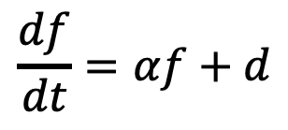

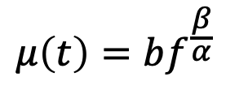



Developing a model for frailty index and mortality
Model 1
$$\frac{df}{dt}=αf+d$$
Exogenous damage rate
Internal damage rate
$$μ\left(t\right)=bf^{\frac{β}{α}}$$
Model for relation between health and mortality
Slide 9
Notes:
Some population there are described by high age independent death rates

Slide 18
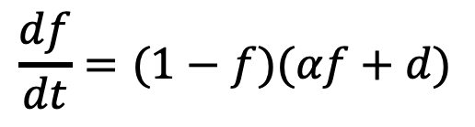

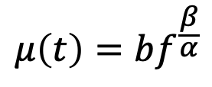

Developing a model for frailty index and mortality
Model 2
saturation term
$$\frac{df}{dt}=(1−f)(αf+d)$$
Exogenous damage rate
Internal damage rate
$$μ\left(t\right)=bf^{\frac{β}{α}}$$
Model for relation between health and mortality
Slide 8
Notes:
Some population there are described by high age independent death rates

Slide 19
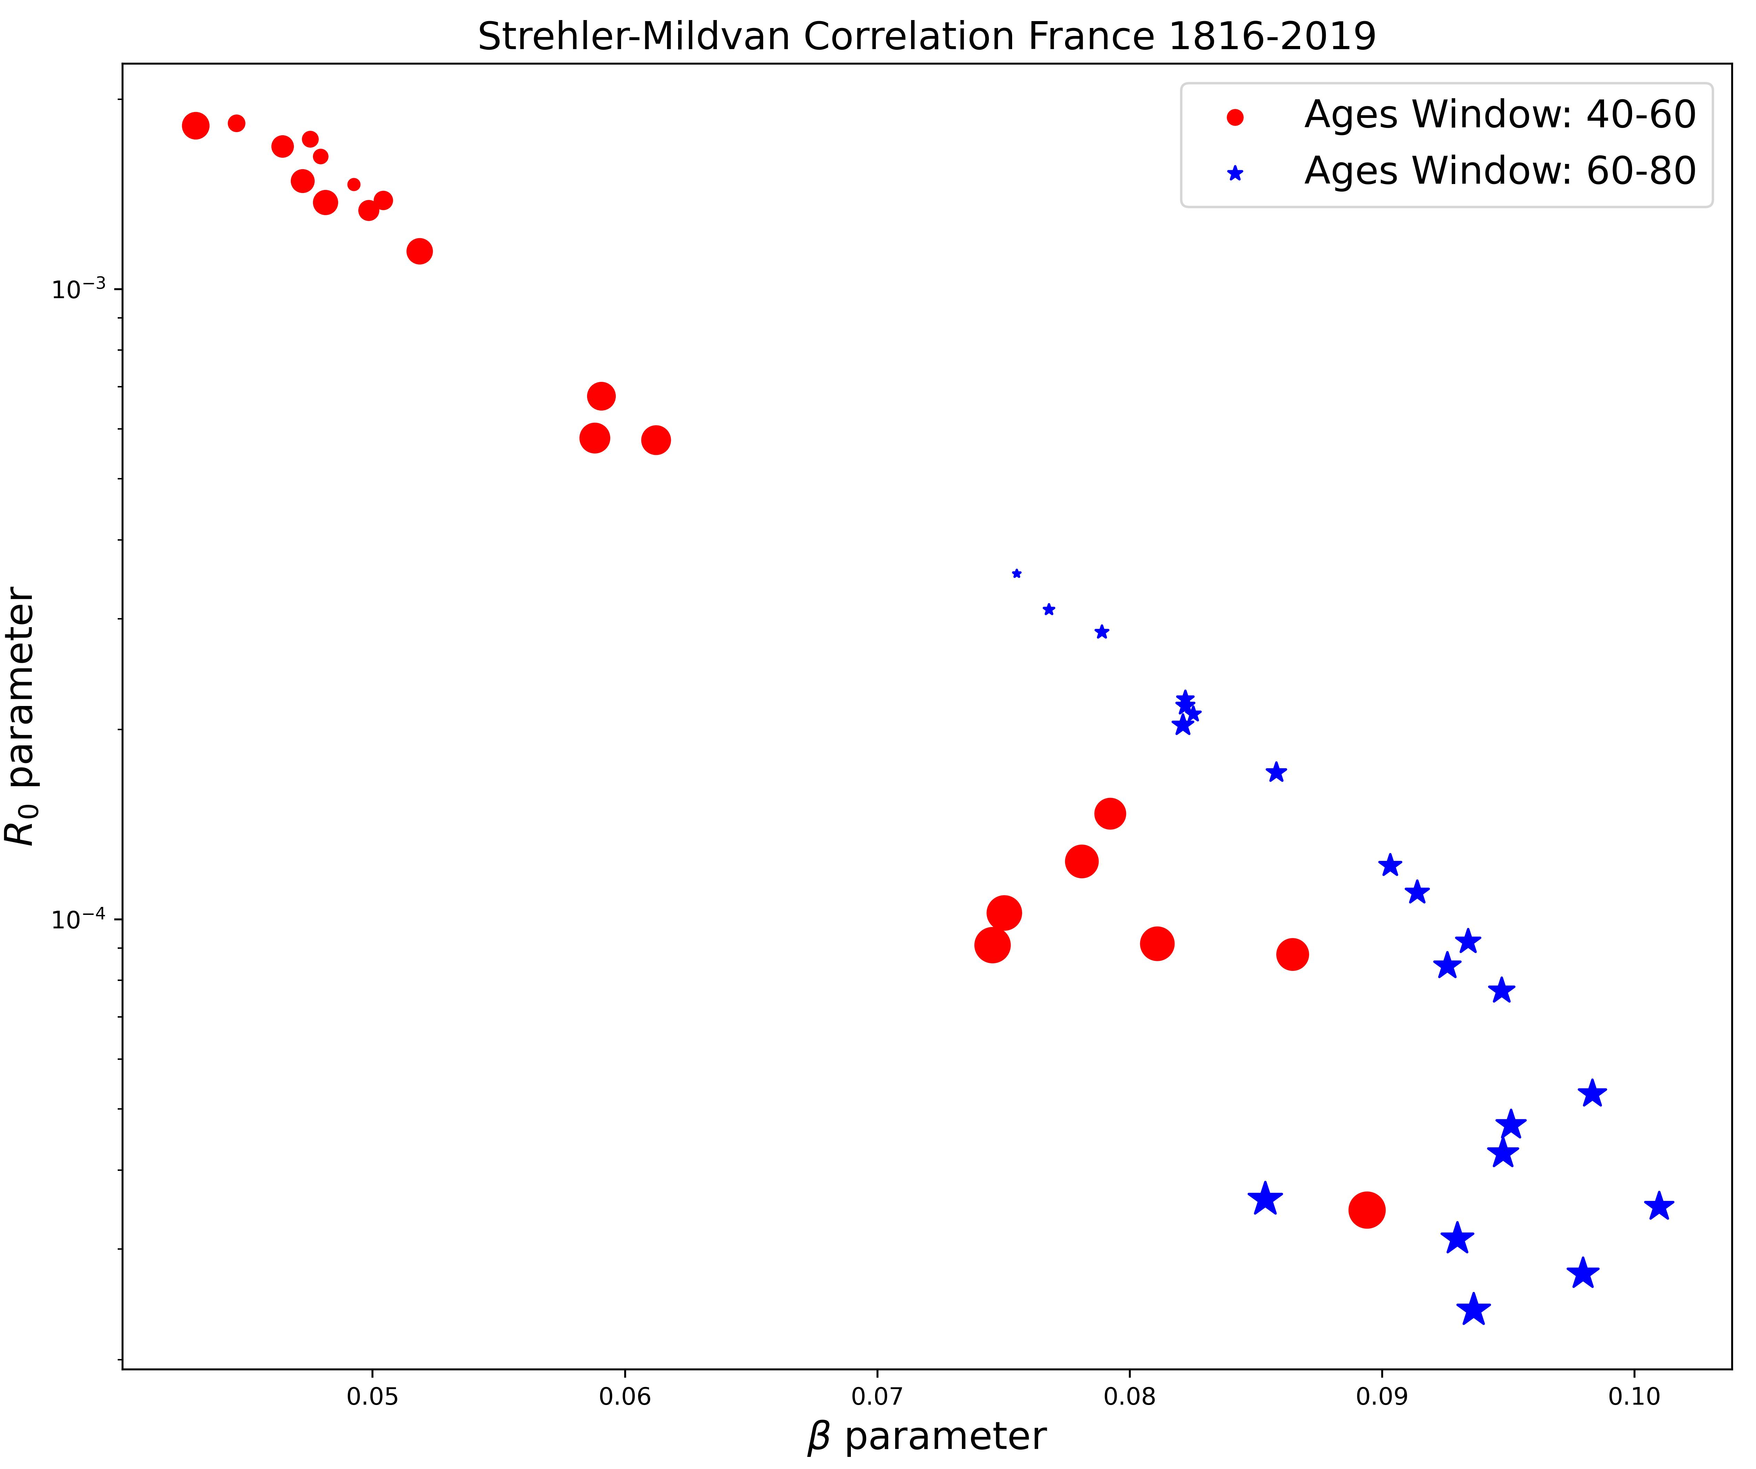
Strehler-Mildvan Correlation phenomenological data
Slide 9

Slide 20
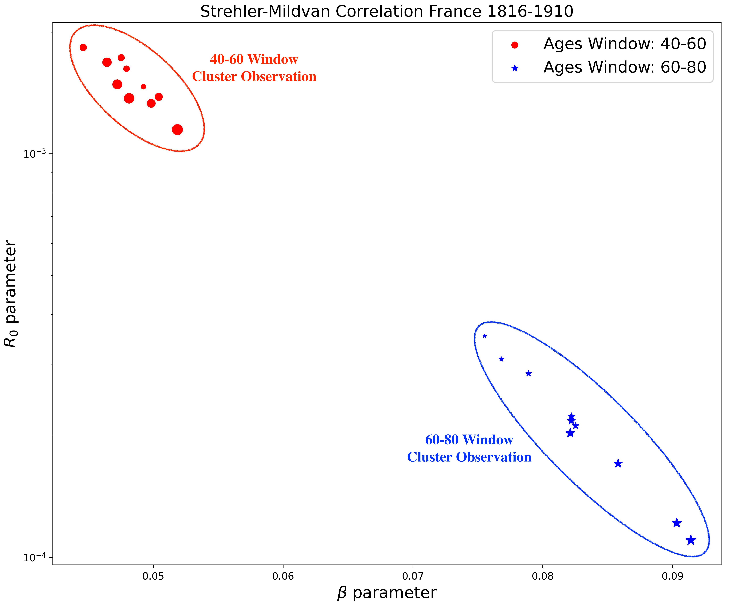
Strehler-Mildvan Correlation phenomenological data
Slide 9

Slide 21
Strehler-Mildvan Correlation phenomenological data
Slide 10

Slide 22
Strehler-Mildvan Correlation phenomenological data
Slide 10

Slide 23
Strehler-Mildvan Correlation phenomenological data
Differences in the correlation between the 40-60 window and the 60-80 window ages.
Slide 10

Slide 24
Strehler-Mildvan Correlation phenomenological data
Differences in the correlation between the 40-60 window and the 60-80 window ages.
Depending on the observation window, there are different values for the parameters of Gompertz’s Law.
Slide 10

Slide 25
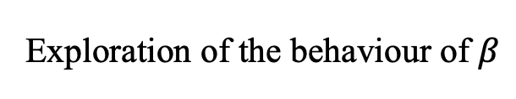
Exploration of Strehler Mildvan Correlation parameters
Exploration of the behaviour of $β$
Slide 11
Notes:
Some population there are described by high age independent death rates

Slide 26
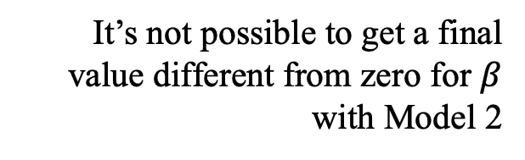
Exploration of Strehler Mildvan Correlation parameters
Exploration of the behaviour of $β$
It’s not possible to get a final value different from zero for $β$ with Model 2
Slide 11
Notes:
Some population there are described by high age independent death rates

Slide 27
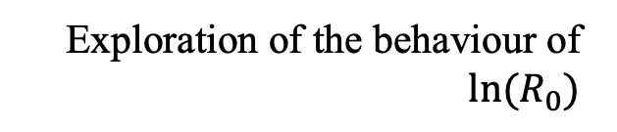
Exploration of Strehler Mildvan Correlation parameters
Exploration of the behaviour of $ln⁡(R_{0})$
Slide 12
Notes:
Some population there are described by high age independent death rates

Slide 28
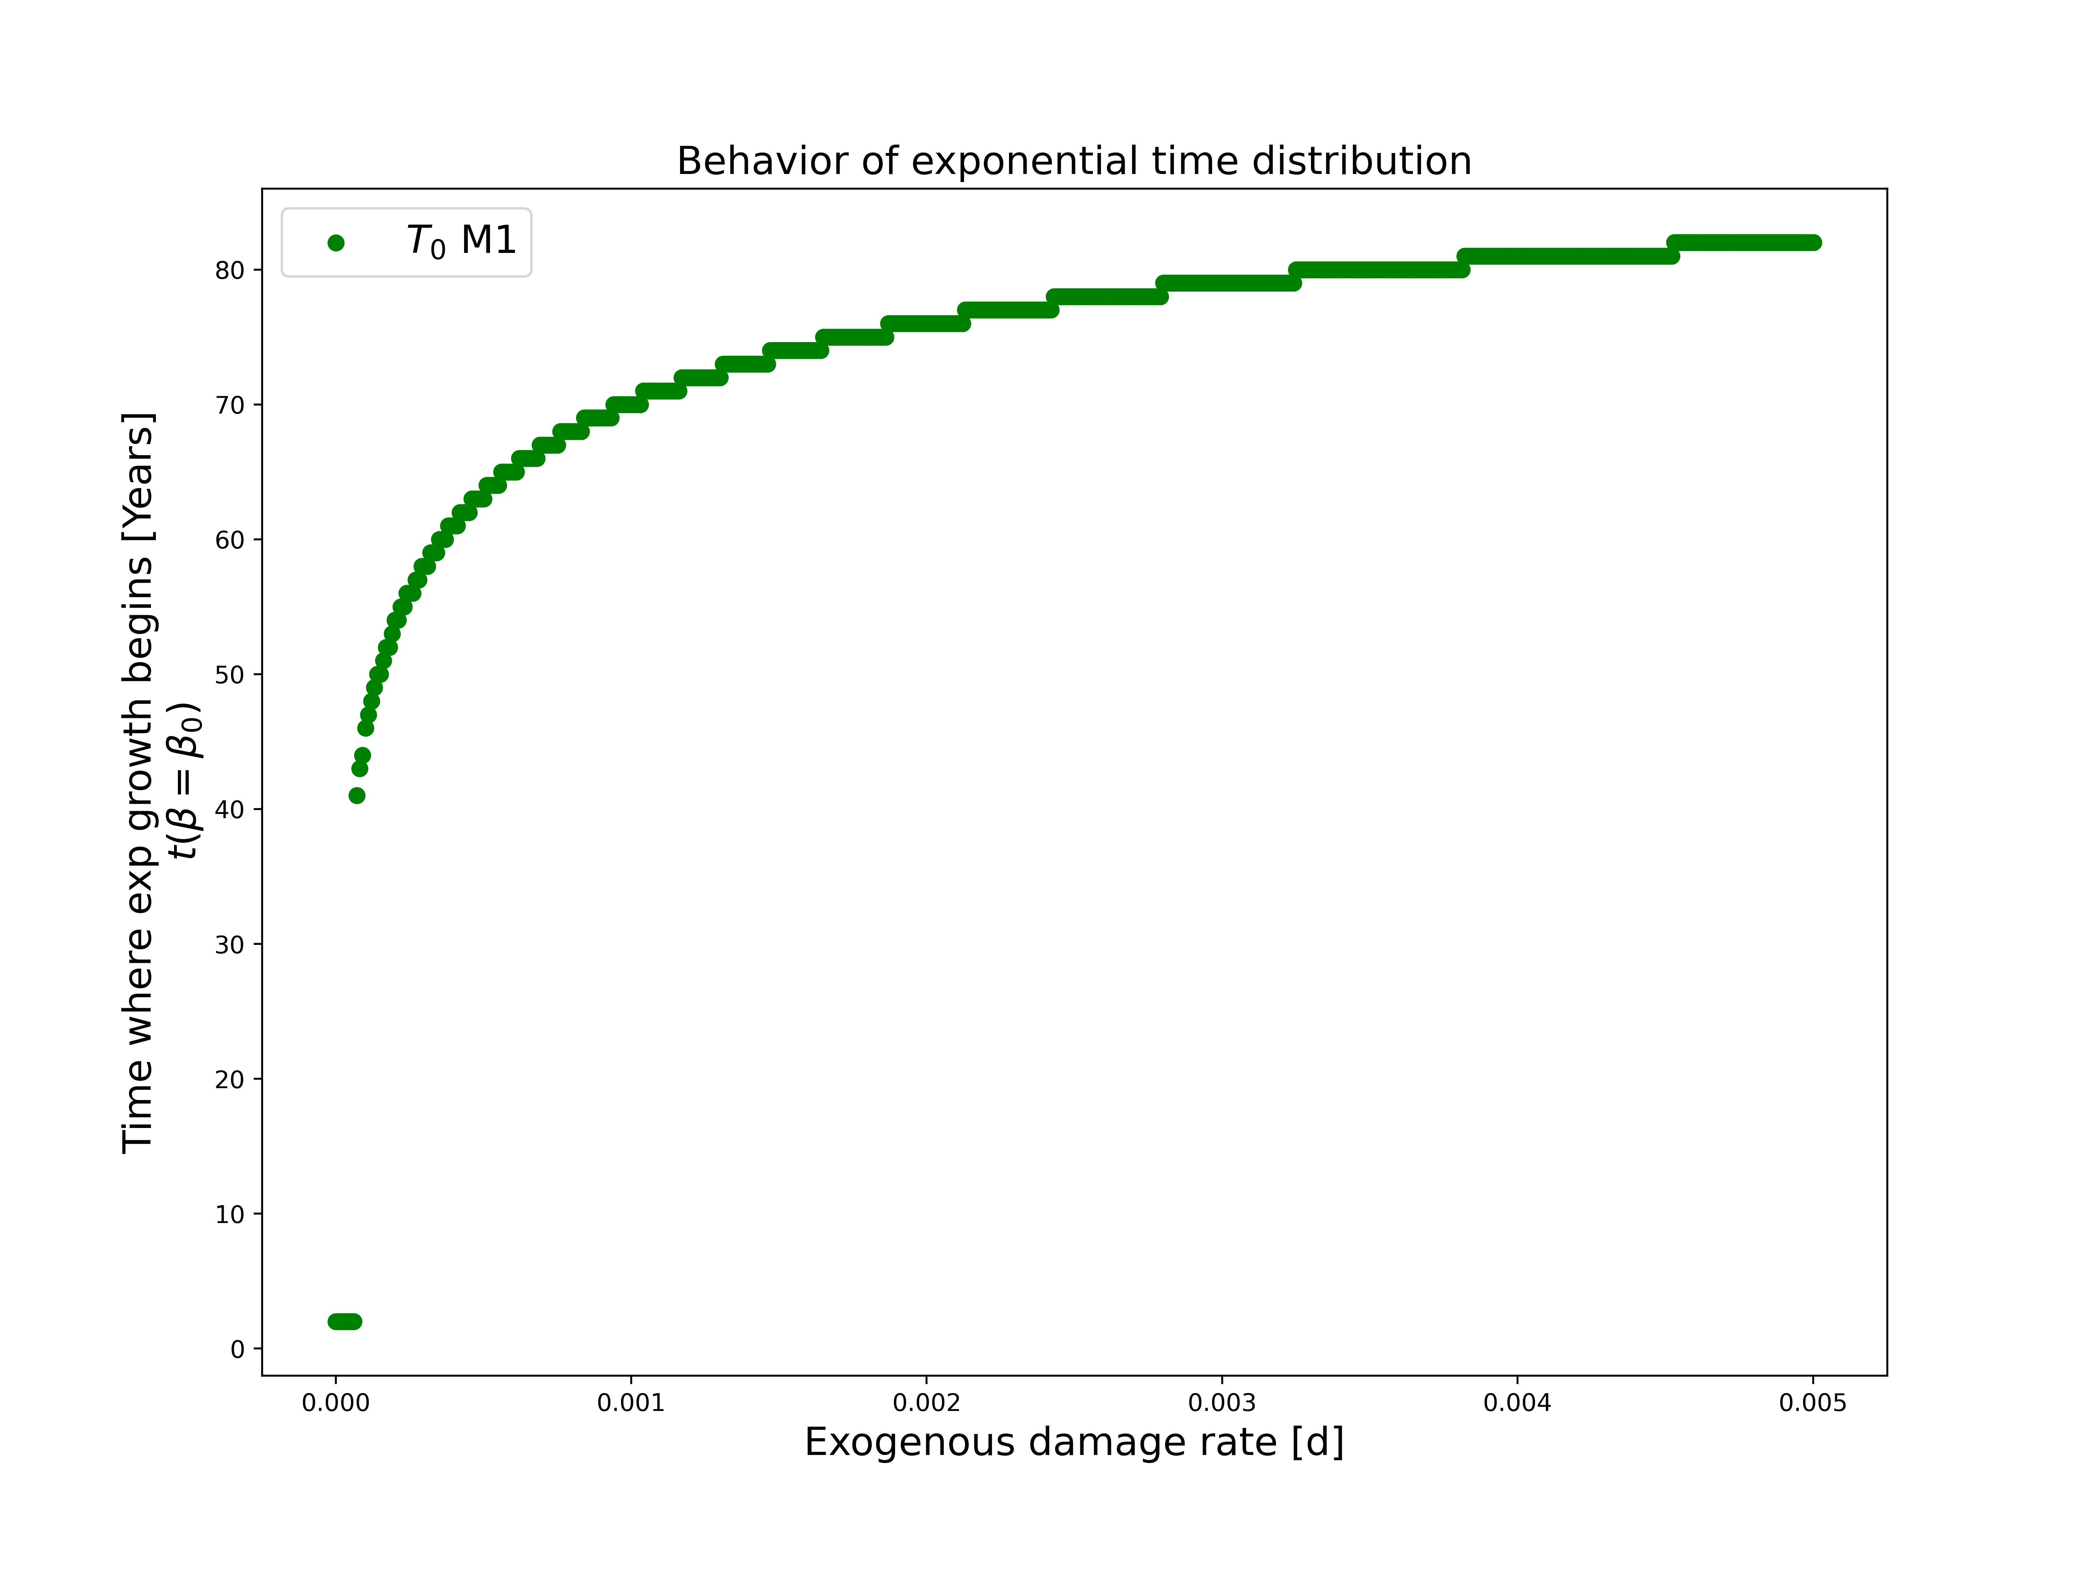
Strehler Mildvan Correlation
Slide 13
Notes:
Some population there are described by high age independent death rates

Slide 29
Strehler Mildvan Correlation
Exogenous damage rate allows for variation in the Strehler Mildvan correlation
The variations obtained do not correspond to the phenomenological data.
Slide 14
Notes:
Some population there are described by high age independent death rates

